Slide 1

Counsel from a Concerned Apostle
2:1 – 10
The Sufficiency of Jesus Christ
Week 44
08 February 2023

Slide 2
Paul’s Pattern of Presentation
Christ Is Preeminent in All Things Supreme Lord - Sufficient Savior
Colossians 1 | Colossians 2 | Colossians 3 |  | Colossians 4
Supremacy of Christ |  | Submission to Christ
Doctrinal and Corrective |  | Practical and Reassuring
What Christ Did For Us |  | What Christ Does Through Us
Christ Our Lord |  | Christ Our Life | Christ our Love
Christ the Head of the Body | Christ the Lord of the Universe | Christ the Head of the Home
Instruction | Warnings | Exhortations | Reminders
Reconciliation | Creation | Submission | Conversation
His Person and Work |  | His Peace and Presence

Slide 3

Colossians Chapter Overview
In Chapter 2, we find Paul writing words of love, understanding, and compassion to people he had never even met; though they shared a mutual friendship with fellow ministry workers Epaphras and Philemon.
Even though Paul and the Colossian believers didn’t know each other personally, they needed each other. As members of the same body of Christ, they were connected, whether they were aware of it or not. So, in this section, Paul shares with his fellow believers in Colossae some:
Personal Encouragement (2:1-5).
Foundational Truth (2:6–7).
Doctrinal Warnings (2:8-10).

Slide 4

Counsel From a Concerned Apostle (2:1-10)

Slide 5
Colossians Lesson Overview
Counsel from a Concerned Apostle!
Swindoll . . . opens this lesson sharing a time in his Christian “adolescence” when he went through an unhealthy phase of spiritual independence. Here’s what he says:
“I though I didn’t need anybody but God or anything but the Bible.”
“I had the Holy Spirit. I was able to read God’s word. I was engaged in my own daily study of Scripture. My parents had played their part in raising me and sending me on a wholesome spiritual trajectory.”
“My wife was there to provide encouragement and companionship. I was plowing forward with a go-it-alone attitude and a pioneering spirit.”

Slide 6
Colossians Lesson Overview
“How wrong I was! As I grew spiritually through the years one of the greatest things I learned was that we need others. Not occasionally but continually. And not just our families and close friends.”
“We need all of our brothers and sister in Christ, both in our local churches and in the universal body of Christ.”
He goes on to say . . . this is one of the most difficult truths to convince believers of. We talk about accepting Christ as our “personal Savior” and having a “personal relationship” with God.
We emphasize the “priesthood of each believer.” However these biblical truths are often misinterpreted through the distorted lens of an unaccountable individualism.

Slide 7
Colossians Lesson Overview
Truth is that each of us must personally accept Christ as Savior, but we are all baptized into “ONE” body, the Church.
Each of us must have our own personal relationship with God, but that relationship is a child-Father relationship with many siblings.
And each of us has the freedom by the power of the Spirit to approach the throne of God without any mediator but the Lord Jesus Christ.
And we are called to pray and intercede for our fellow believers, serving as priests and ministering to one another.
So having a alone-ranger mentality isn’t biblically supported.

Slide 8
Colossians Lesson Overview
While we rightly emphasize the importance of personal Bible study, sometimes we neglect the equally important aspects of Christian community and accountability.
What an unbalanced and unhealthy way to live the Christian life!
When we realized that the great apostle Paul who labored on the frontier of missions, surrounded himself with people. It should jolt us out of our privatized Christianity.
Paul’s ministry to us through the many letters he wrote is filled with names of fellow workers, companions, friends and colleagues; is more evidences “that ministry is most effectual when done in the context of community.”

Slide 9
Colossians 2:1 – 5
¹For I want you to know what a great conflict I have for you and those in Laodicea, and for as many as have not seen my face in the flesh, ²that their hearts may be encouraged, being knit together in love, and attaining to all riches of the full assurance of understanding, to the knowledge of the mystery of God, both of the Father and of Christ, ³in whom are hidden all the treasures of wisdom and knowledge. ⁴Now this I say lest anyone should deceive you with persuasive words. ⁵ For though I am absent in the flesh, yet I am with you in spirit, rejoicing to see your good order and the steadfastness of your faith in Christ.

Slide 10
Colossians 2:1 – 5
The thoughts from 1:29 where Paul mentioned that in his ministry as an apostle, he was determined to labor, striving according to the power of Christ working in him, flows right into the first verse of chapter two.
In Colossians 2:1, Paul makes this striving personal: “I want you to know how great a struggle I have on your behalf and for those who are at Laodicea, and for all those who have not personally seen my face” (NASB).
Paul expressed that his labor in ministry also benefited the church at Laodicea, and all the neighboring churches who had not met him face-to-face.

Slide 11
Colossians 2:1 – 5
Paul’s desire for his labor was that by it, all the churches in the region would be encouraged by having their hearts “knit together in love” (2:2).
The word used here for “knit together” is the same word used in Ephesians to describe how the body of Christ is “fitted and held together by what every joint supplies” as each part works together to build up the whole body “in love” (Eph. 4:16)
Paul is saying that this spiritual growth of the body that occurs as the members are fitted together in love results in “all the wealth that comes from a full assurance of understanding” (2:2).
This full assurance of understanding being “a true knowledge of God’s mystery” (2:2).

Slide 12
Colossians 2:1 – 5
Remember the Gnostic false teachers emphasized seeking mysterious knowledge (gnosis) but as something beyond Jesus Christ.
Paul says, the true knowledge of God’s mystery is, “Christ Himself, in whom are hidden all the treasures of wisdom and knowledge” (2:2-3).
This was a bold, blunt, direct refutation of these growing Gnostic heresies and Paul confirms this fact in verse 4, when he said “I say this so that no one will deceive you with persuasive arguments.”
The speculations of the false teachers were fascinating and their rhetoric tantalizing, they wowed their hearers with sophisticated “facts” and intricate “logic.”

Slide 13
Colossians 2:1 – 5
They demote, decentralized, or downplay the person and work of Jesus Christ. Every step of their mesmerizing methodology steered their listeners farther away from Christ.
Because Jesus alone is the treasure trove of wisdom and knowledge, the only way false teachers can persuade people to buy their fools gold philosophies is to turn their attention away from Christ and toward the fabulous fabrications they espouse.
These false teachers posed a real danger, but instead of dwelling on their potential threats, Paul follows his warning with affirmation, in verse 5, where he says, “though I am absent in the flesh, yet I am with you in spirit.”

Slide 14
Colossians 2:1 – 5
This isn’t just a cliché phrase meaning “I got your back.”
It’s a statement of fact for the body of Christ. In reality Paul and the believers in Colossae were united by the bond of the Holy Spirit, who brings together in spiritual unity members of the body of Christ who are separated physically.
Therefore, Paul’s thoughts and emotions were with them as he expressed genuine interest and concern for them. He commended them for their good discipline and the stability of their faith in Christ.
Paul rejoiced that they were living as they should and that they had a firm footing in the truth of the Christian faith.

Slide 15
Colossians 2:6 – 7
⁶As you therefore have received Christ Jesus the Lord, so walk in Him, ⁷ rooted and built up in Him and established in the faith, as you have been taught, abounding in it with thanksgiving.

Slide 16
Colossians 2:6 – 7
To continue strengthening the Colossians in their faith, Paul adds to his affirmation from verse 5, an exhortation to follow the way of Christ (2:6-7).
Here Swindoll suggests . . . that the essence of the Christian life is packed into these two verses and he highlights four foundational truths about the Christian Life:
It starts with new birth (2:6).
It continues when we “walk in Him” (2:6).
It continues as stability and growth occur (2:7).
It continues as we mature gratitude overflows (2:7).

Slide 17
Colossians 2:6 – 7
FIRST – The Christian life starts with new birth.
“As you therefore have received Christ Jesus the Lord, so walk in Him” (2:6).
The new birth is a sovereign act of God by the Holy Spirit in which the believer is cleansed from sin and given spiritual birth into the family of God; it renews the believers intellect, sensibility, and will to enable that person to enter the kingdom of God; to be transformed by following the teachings of Jesus Christ and to do good works as God’s servant.
This new birth process started when we “received” the Lord Jesus Christ as our Lord and Savior.

Slide 18
Colossians 2:6 – 7
SECOND – The Christian life continues when we “walk in Him.”
“As you therefore have received Christ Jesus the Lord, so walk in Him” (2:6).
Like newborn babies, we grow slowly at first. Later we learn to put one foot in front of the other as we start to understand what it means to be a Christian and grasp the basic truths about out faith.
We learn what is expected of followers of Christ: how to pray, how to read His Word, how to deal with sin, and how to resist temptation.
And as we stay close to Him and keep our focus on Him, we continue to walk in the right direction toward spiritual maturity. But all of this take time.

Slide 19
Colossians 2:6 – 7
THIRD – As the Christian walk continues stability and growth occur.
“Rooted and built up in Him and established in the faith, as you have been taught . . . ” (2:7).
Paul uses the image of a tree being “firmly rooted” followed by a structural metaphor being “built up in Him.” What we see is a consistent picture of our walk unfold.
As we grow, we become more stable, and with this stability comes greater maturity and the outworking of our spiritual maturity resulting in even greater stability.

Slide 20
Colossians 2:6 – 7
FOURTH – As the Christian walk matures it’s marked by overflowing gratitude.
“. . . abounding in it with thanksgiving” (2:7).
The mature believer knows that his or her spiritual growth comes from God, who by the Holy Spirit provides what is needed to conform Christians to the image of Christ.
Paul’s words suggest that as we mature in our faith, thanksgiving should increase. Therefore, the appropriate response to God’s provision of growth and strength is not pride or self-confidence, but overflowing gratitude and thanksgiving.

Slide 21
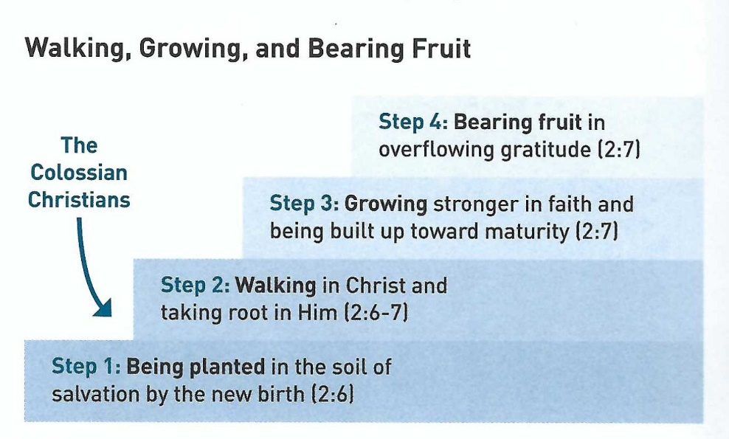
Colossians 2:6 – 7
Four foundational steps of the Christian Life

Slide 22
Colossians 2:8 – 10
⁸Beware lest anyone cheat you through philosophy and empty deceit, according to the tradition of men, according to the basic principles of the world, and not according to Christ. ⁹For in Him dwells all the fullness of the Godhead bodily; ¹⁰and you are complete in Him, who is the head of all principality and power.

Slide 23
Colossians 2:8 – 10
Paul knew that of the four steps outlined above, the Colossians Christians were standing somewhere between steps one and two in their growth in the Christian faith.
They had been truly converted, were becoming stable in the Christian faith, and were beginning to live the Christian life. But they were like freshman in the lifelong curriculum of spiritual growth.
Thus the Colossians were prime targets for spiritual deception from false teachers, who prefer to target the newly converted. So in Colossians 2:8-10, Paul transitions to stern doctrinal warnings.

Slide 24
Colossians 2:8 – 10
In 2:4, Paul had warned the Colossians about being deceived by “persuasive words.”
Now he expands on this warning. Paul doesn’t merely caution against smooth talk by slick charlatans. Rather, he addresses deeper, darker levels of false teaching by which the victims are not just deceived, but are taken captive (2:8).
The image here is not just of people falling into a trap, but of people being snatched and dragged off as if being kidnapped. It’s a violent sobering image, intended to shock the Colossians to attention.

Slide 25
Colossians 2:8 – 10
How did these false teachers capture and carry their victims away from the truth?
FIRST – “The false teachers sought to capture them through “philosophy and empty deception” (2:8).
Here Paul isn’t condemning all philosophy, or science, but false, baseless, demonic, worldly philosophy concocted by man to confuse and deceive Christians.
The burgeoning Gnosticism that threatened the baby Christians in Colossae was probably some sort of amalgam of selected Christian teachings and pagan mysticism, held together with a heavy dose of Platonic philosophy, and all of it badly twisted and distorted.

Slide 26
Colossians 2:8 – 10
How did these false teachers capture and carry their victims away from the truth?
FIRST – “The false teachers sought to capture them through “philosophy and empty deception” (2:8) – continue . . .
This philosophy that threatened the Colossian Christians was a strange eclectic mix of early Gnosticism, Greek philosophy, local mystery religions, and Jewish mysticism.
And it was so dangerous because it was not obviously sinful and licentious. It was high-sounding and seemed highly intelligent.

Slide 27
Colossians 2:8 – 10
How did these false teachers capture and carry their victims away from the truth?
SECOND – “The false teachers followed the traditions of men and basic principles of the world” (2:8).
Whether through the influence of wretched people or wicked spirits, these false teachers were drawing people away from Jesus Christ.
The traditions of men, are the traditions among the Jews or the Greek philosophers or both.
Paul here warned that the traditions of men has no equal authority to the word of God.

Slide 28
Colossians 2:8 – 10
How did these false teachers capture and carry their victims away from the truth?
SECOND – “The false teachers followed the traditions of men and basic principles of the world” (2:8) – continue . . .
Basic principles of the world, is said to be knowledge which is very advanced and very profound.
When in fact it is knowledge which is uninstructed and rudimentary because, at the best, it is knowledge of the human mind.

Slide 29
Colossians 2:8 – 10
As a defense against this two-pronged attack by the malicious false teachers, Paul again turns the focus to Jesus Christ.
“In Him dwells all the fullness of the Godhead bodily” (2:9).
This means that Jesus Christ is God incarnate (John 1:1-3, 14). He is fully divine and fully human. He is undiminished Deity – including all the attributes, power, glory, honor, and authority of Deity – united with perfect humanity.
A single dose of the doctrine of the incarnation would instantly cure the disease of Christ-denying heresy.

Slide 30
Colossians 2:8 – 10
Paul’s use of the word pleroma (fullness) was intentional.
This term “pleroma” had a special significance in Gnosticism. One scholar provides the following description of its Gnostic usage:
“What then is the pleroma? It is the fullness, the totality, the completeness of all things. From it all good has come, to it all good will return and be taken up completely in it. That what has come from it are the aeons and the “spiritual” seed in some of humanity. Indirectly, all evil has come for it also.”
By declaring that the fullness of Deity dwells in Christ in bodily form (2:9), Paul both refutes the mythical, speculative notion of pleroma in Gnosticism and counters the dualistic nature of their false religion.

Slide 31
Colossians 2:8 – 10
The Gnostics despised the body, the physical world, and all things material. They believed the physical world – especially the fleshly body – to be inherently evil. To confess that the fully divine Son of God could dwell in bodily form would have been anathema to those heretics.
Because of who Christ is—the God-man—He is able to fully accomplish His saving and sanctifying work. In 2:10, Paul strongly affirms the total sufficiency of Christ: “In Him you have been made complete.”
There is no need to seek so-called fullness anywhere else and not need to find additional saving wisdom, insight, knowledge understanding or truth from any other philosophy.

Slide 32
Colossians 2:8 – 10
In fact, even the angelic spiritual realm that so fascinated Gnostics was under His authority:
“He is the head over all rule and authority”(2:10).
Jesus Christ is sufficient as Lord.

Slide 33
Applications
Of the
lesson
Watering Our Roots

Slide 34
Application - Watering our roots
No matter where we are in our process of spiritual growth, we need to keep our spiritual roots healthy, deep, and strong. But how do we do this?
What can we do to remain firmly rooted in our faith?
Swindoll suggest three things we can do to apply this lesson.
FIRST – Once every week affirm and encourage another believer.
Just as Paul went out of his way to exhort, encourage, warn, and teach other believers, you can do the same.
You’ll find that your love and concern for others, being with them “in spirit,” not only helps to strengthen their roots but will also grow your own.

Slide 35
Application - Watering our roots
You could do this through a personal meeting, a phone call, a card, an email, or even a brief text message.
Make yourself available, demonstrating that your brothers and sisters in Christ are not alone. And before you know it you’ll find that you’re the recipient of others notes of encouragement.
SECOND – Once a day, think of something for which you are grateful and tell the Lord, “Thank You.”
Thank God for the food he provides and the friends He has brought into your life. Thank God for health, for deliverance from various temptations, and for perseverance through trials. Thank God for salvation in Jesus Christ and the hope of eternal life, thank Him for the big things and for the little things He provides.

Slide 36
Application - Watering our roots
THIRD – Morning, noon and night, pause and remind yourself, “I am complete in Christ.”
Remember you are fully accepted by God because of the person and work of Jesus Christ – not because of your own worth or merit.
Recall that you’re totally free from the eternal punishment of sin. Acknowledge that Christ has broken the power of sin’s dominance in your life, allowing you to walk in a manner worthy of His calling (Col.1:10; Eph 4:1).
Rejoice in the fact that you are absolutely secure in His salvation and will be fully delivered from the presence of sin when Christ returns.

Slide 37
Application - Watering our roots
Remember:
By consistently sharing encouragement with others.
Regularly expressing your gratitude to God.
Continually recalling the all-sufficiency of Christ.
You’ll be watering the roots of your faith that nourish spiritual growth.

Slide 38



Slide 39
NEXT CLASS – 15 Mar 2023
Book of Colossians
Before next class, read the below chapters in the NKJV and in one other versions of the Bible, i.e., KJV, NRSV, NIV, CEV, etc …
Chapter 2:11 – 2:23
“Living Forgiven … and Free”

